Slide 1
Modeling Viral Evolution:
A Multi-Strain SIR Simulation of Myxoma in Rabbit Populations
-KunQi Zhang & Luan Tian

Slide 2
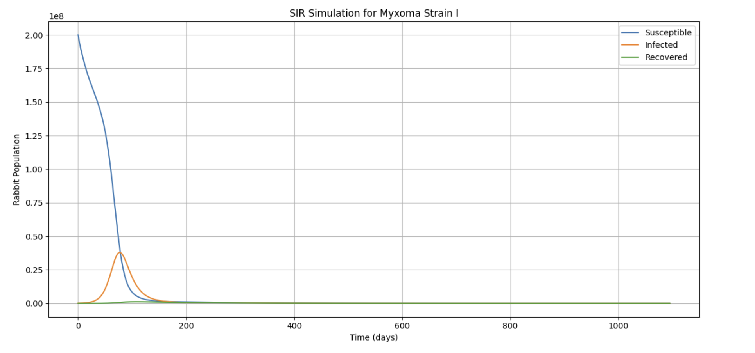

Slide 3
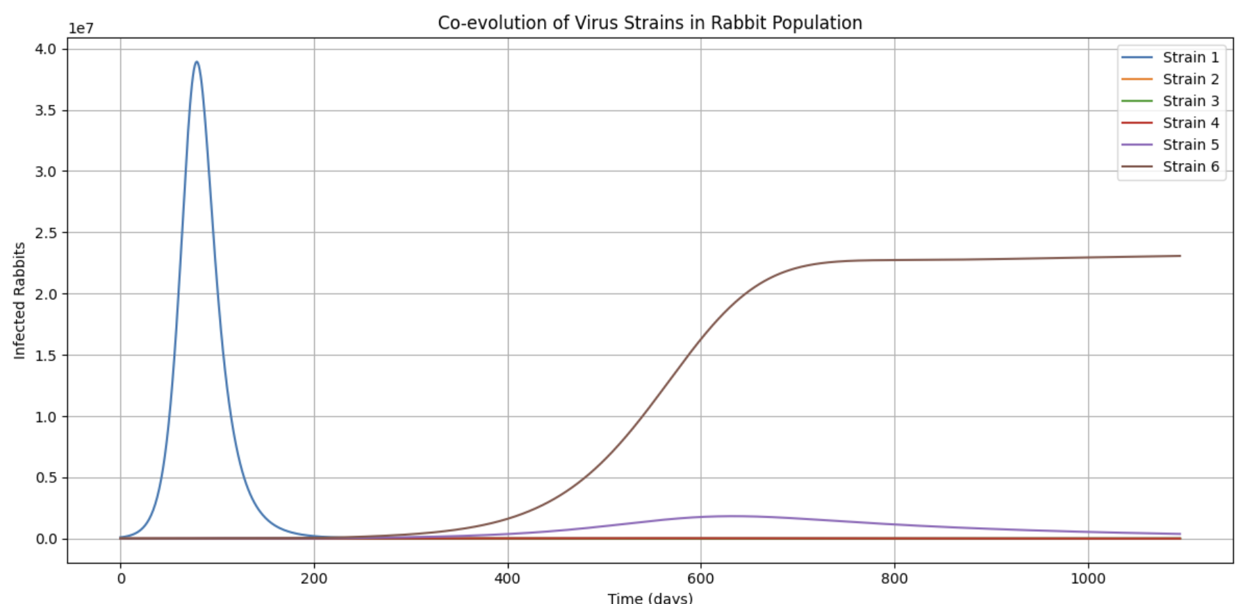

Slide 4
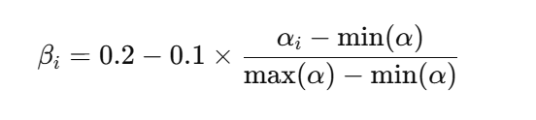
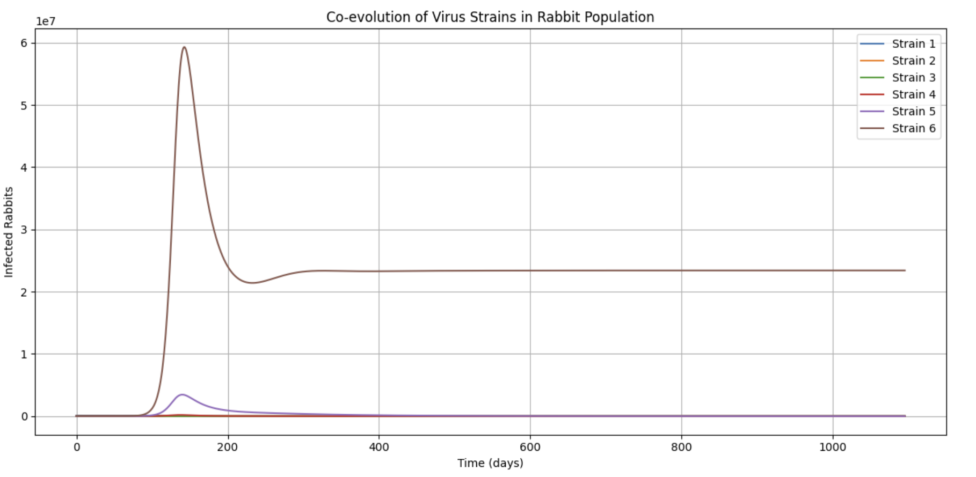

Slide 5
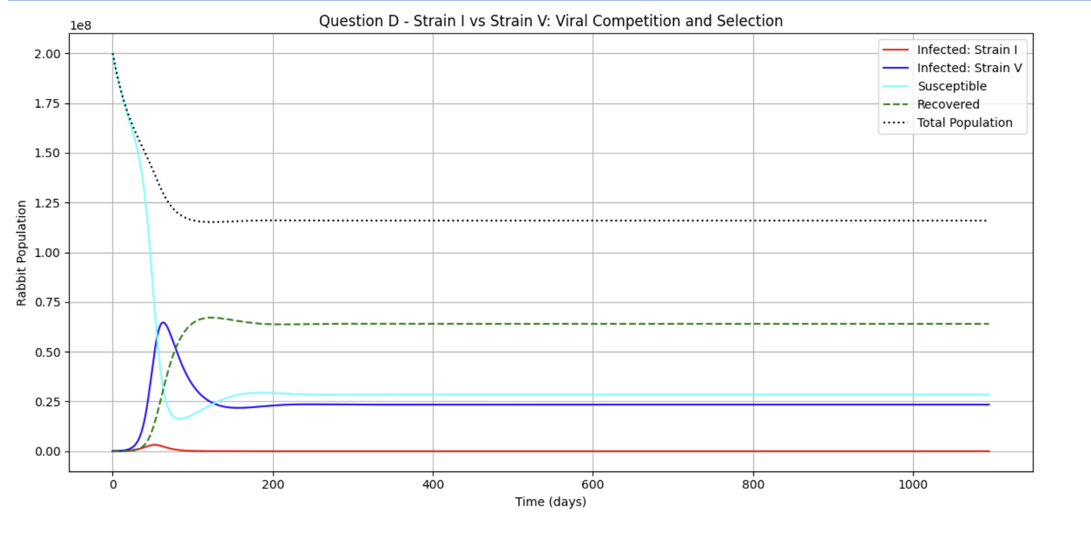
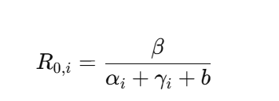

Slide 6
Thank you!

